Slide 1
DFIR Summit 2021 - Presentations - Resources - Tools
Dr. John W. Carls, CISSP, C|EH

Slide 2
Presentations
Keynote - Cobalt Strike Threat Hunting
A Holistic Approach to Defending Business Email Compromise Attacks
Breaches Be Crazy
Crossing the Threshold - Analysis of the Facebook Mini Portal
Exploring Windows Command-Line Obfuscation
Forensic Analysis of Xiaomi IoT Ecosystem
Order of Volatility in Modern Smartphone Forensics
The Cyber Kill Chain Meets Blockchain
UFOs - Unidentified Forenic Objects
Validating Evidence for Courtroom Testimony
Where Have UAL Been

Slide 3
Cobalt Strike Threat Hunting
Penetration testing and adversary emulation suite
Beacon is a stable platform for:
Remote access • Exploit/payload deployment • Lateral movement
Memory Detection
Named Pipes
PowerShell Log Detection

Slide 4
A Holistic Approach to Defending Business Email Compromise (BEC) Attacks
Step 1 Investigation Kickoff
Step 2 Preparation Collection
Step 3 Forwarding Rules
Step 4 Login activity
Step 5 Permission changes
Step 6 OAuth 2 Abuse
Step 7 Evasion techniques
Step 8 Assess Data Accessed or Exfiltrated
Step 9 Threat Intelligence, Phishing Emails and Malware
Step 10 Recommendations

Slide 5
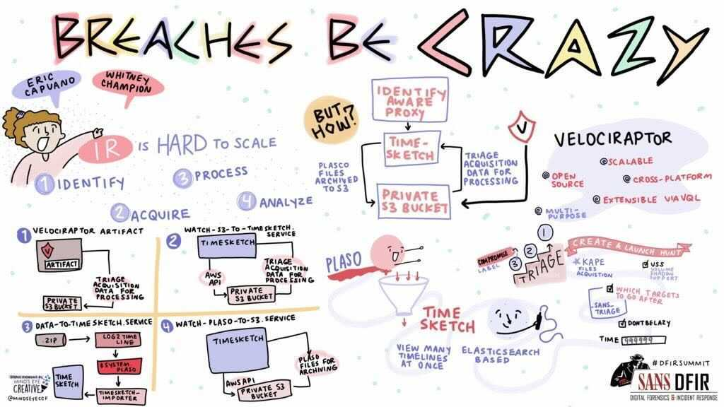
Breaches Be Crazy
Scaling Forensics Across Many Systems
IR is Hard to SCALE
1. Identify compromised systems
Without a SIEM? Good luck!
2. Acquire forensics images
Many+ hours
3. Process forensic images
Many+ hours *per* image
4. Analyze forensic data
One! system! at! a! time!
https://github.com/ReconInfoSec/velociraptor-to-timesketch

Slide 6
Crossing the Threshold - Analysis of the Facebook Mini Portal
Tested Portal & Apps
Found Hidden USB / Bluetooth Connection
Portal Mini Easter eggs can be found in Snapshots
Portal Mini Easter eggs can be found in Facebook messages
All kinds of Easter eggs present in Facebook data

Slide 7
Exploring Windows Command-Line Obfuscation
Historically the only way for a user to interact with their Computers
Nowadays “under the hood”
Opportunities to bypass detection/prevention mechanisms
Replace the option char with another one
Instead of looking for a process/command
Look for the file/registry/network events that follow
Even without command line obfuscation, we know command lines can be spoofed

Slide 8
Forensic Analysis of Xiaomi IoT Ecosystem
Introduction
One of the world’s biggest manufacturers (smartphones and IoT)
Equipment and Setup
Evidence Extraction
Forensic Analysis
Findings and Points of Consideration
The forensic analysis of Mi Home application can provide information about:
Smarthome’s structure (Rooms, IoT devices present, etc.)
Smarthome’s Automation system (Scenes’ configuration, logs, etc.)
Smarthome’s devices’ logs or/and settings
Owner’s personal information
Conclusion

Slide 9
Order of Volatility in Modern Smartphone Forensics
RFC 3227 – February 2002
When collecting evidence you should proceed from the volatile to the less volatile
Example order of volatility for a typical system
registers, cache
routing table, arp cache, process table, kernel statistics, memory
temporary file systems
disk
remote logging and monitoring data that is relevant to the system in question
physical configuration, network topology
archival media
DUMPSYS is a tool that runs on Android devices and provides information about system services
https://developer.android.com/studio/command line/dumpsys

Slide 10
The Cyber Kill Chain Meets Blockchain
Myth Busting
Why Blockchain for DFIR?
Case Studies
Prevention
Attribution Strategies
Investigation + Disruption
Resources

Slide 11
UFOs - Unidentified Forenic Objects
Artifact Examiner

Slide 12
Validating Evidence for Courtroom Testimony
Six (6) Steps
Step 4: Validation
Types:
Visual
Cross Tool
Call Data Records
CCTV
Carving
Replication
Follow source file for artifact
Explore relevant files
Validate TimeStamps

Slide 13
Where Have UAL Been
Research/information about User Access Logging (UAL)
Demonstrate how to:
Access UAL data
Parse UAL data
Kstrike - UAL Data Parsing
https://github.com/brimorlabs/KStrike
Eric Zimmerman’s “SumECmd”
https://github.com/EricZimmerman/Sum

Slide 14
Resources
DFIR 101 - Digital Forensics Essentials
Automating Google Workspace Incident Response
EZ Tools, KAPE, and How to Contribute to and Benefit from Open Source Contributions
Greppin Logs
Incident Response 9-Line
IR Playbooks
OCR’ing the Bitmap Cache Puzzle
SANS 2021 DFIR Survey Results
SANS Technology Institute Information Session
Stringlifier - An Open Source Tool for Random String Classification
Reporting for Digital Forensics
Scoring and Judging Artifacts in Autopsy

Slide 15
DFIR 101 - Digital Forensics Essentials
101.1 What is Digital Evidence?
Digital evidence is simply information that is stored or transmitted in a digital format that may be of value to an investigation
101.2 What is Digital Investigation?
The process of gathering and analyzing data, with the purpose of determining and reporting on any actions that were performed on that system, which may be relevant to the case
101.3 What is Digital Forensics?
The process of identifying, preserving, analyzing and presenting digital evidence in a manner that is legally acceptable
101.4 How can Digital Forensics Help me?

Slide 16
Automating Google Workspace Incident Response
To increase IR capabilities in Google Workspace:
Provide better view of log data
Enrich log data for more context
https://github.com/megan201296/gsuite-dfir

Slide 17
EZ Tools, KAPE, and How to Contribute to and Benefit from Open Source Contributions
Forensic Tools and their ancillary files covered
RECmd - Batch files
SQLECmd - Maps
EvtxECmd - Maps
KAPE - Targets/Modules
Why should I care about this topic?
Know what makes your tools tick to better speak to the magic that’s going on behind the scenes
Know what’s going on behind the scenes to help make it BETTER for yourself and others
Strongly consider helping to make the tools better because it very well could save someone’s life or help solve a case/engagement that doesn’t involve life or limb

Slide 18
Greppin Logs
Introductions and Guiding Principles
Forensics is Data Engineering and Data Science
Core Unix Command Line Tools
Processing Structured Data
Performance Upgrades
Lightgrep - https://github.com/strozfriedberg/lightgrep
Lightgrep is a new regular expression engine, designed specifically for digital forensics
Scaling with AWS

Slide 19
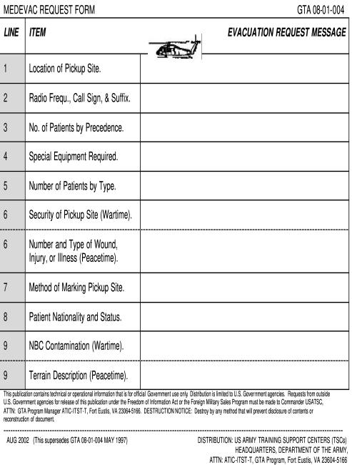
Incident Response 9-Line
Incident Response Challenges
Various Teams: Security OPS, IR, Security Mgmt
Logs roll over quickly and evidence at risk of destruction
Stress of Incident creates comms gaps
Incident Response Questions
What kind of incident? / How bad? / How many systems? / Are we blocking them?
Follow MEDEVAC 9-LINE
1. Date and Time of Detection 2. Reporting Person
3. Incident Type 4. Incident Severity
5. Number of Systems Impacted 6. Patient Zero Identified
7. Tactics Identified 8. Indicators of Compromise
9. Actions Taken

Slide 20
IR Playbooks
Background
Current Playbooks
Our Hybrid Format
Our Current Playbooks
How to Contribute
https://gitlab.com/syntax-ir/playbooks/

Slide 21
OCR’ing the Bitmap Cache Puzzle
WHAT IS IT?
Small Cached images from RDP sessions
Helps improve bandwidth of Remote Desktop sessions
WHAT DOES IT TELL ME?
Provides snippets of visual information that can help confirm activity observed in other artifacts
Programs open during RDP sessions
Date / timestamps
Files and folders accessed / viewed
Can provide a small window into the perspective of the attacker
https://github.com/DFIR-Drew/OCR-Bitmap-Cache

Slide 22
SANS 2021 DFIR Survey Results

Slide 23
SANS Technology Institute Information Session
The SANS Technology Institute transforms the world’s best cybersecurity training and certifications into a comprehensive, rigorous, graduate and undergraduate education experiences
Academics
Degree Programs
Certificate Program
Bachelor’s Degree
Master’s Degree
Student Resources

Slide 24
Stringlifier - An Open Source Tool for Random String Classification
How to simplify your data science life with one tool
Anomaly Detection
Engineering Solution: REGEX
https://github.com/adobe/stringlifier

Slide 25
Reporting for Digital Forensics
Introduction
The Importance of Reports
Expect to be Cross-Examined
Expert Witness Must Provide a Written Report
Guidelines for Writing
Abstract (or summary)
Table of Contents
Body of Report
Conclusion
References
Glossary
Acknowledgements
Appendixes
Generating Reports

Slide 26
Scoring and Judging Artifacts in Autopsy
Problem: Data Overload
Cases involve an increasing number of devices
Devices are getting bigger and bigger
We’ve been talking about this for years…
We need better solutions to deal with it
What is Autopsy?
Open source digital forensics platform
General purpose for all kinds of investigations
Has been designed for:
Ease of use
Showing results ASAP
Extensibility (many plug in frameworks)
Has the features you need
Free to download:
http://www.autopsy.com

Slide 27




Tools
https://www.sans.org/tools/?&focus-area=digital-forensics

Slide 28

SIFT Workstation
Collection of free and open-source incident response and forensic tools
Designed to perform detailed digital forensic examinations in a variety of settings
Can match any current incident response and forensic tool suite
Demonstrates advanced incident response capabilities and deep-dive digital forensic techniques
Accomplished using cutting-edge open-source tools that are freely available and frequently updated
https://www.sans.org/tools/sift-workstation/

Slide 29

Eric Zimmerman’s Tools
Open source digital forensics tools used in a wide variety of investigations
Cross validation tools
providing insight into technical details not exposed by other tools
Continually improve over a dozen digital forensics tools that investigators all over the world use and rely upon daily
See POSTER

Slide 30

SOF-ELK
“Big data analytics” platform focused on the typical needs of computer forensic investigators/analysts and information security operations personnel
Customized build of the open source Elastic stack
Initially developed for SANS FOR572: Advanced Network Forensics and Analysis
https://www.sans.org/tools/sof-elk/

Slide 31

REM.NUX
REMnux® is a Linux toolkit for reverse-engineering and analyzing malicious software
REMnux provides a curated collection of free tools created by the community
Analysts can use it to investigate malware without having to find, install, and configure the tools
REMnux toolkit also offers Docker images of popular malware analysis tools
Run tools as containers without having to install them directly on the system
Run the REMnux distro as a container
https://www.sans.org/tools/remnux/
https://remnux.org/

